Slide 1
Virtual PIANO
CSIT 4th Semester
A Java Project
Aabhash Shakya
Abhushan Malla

Slide 2
Acknowledgement
We are very thankful towards our Java teacher Mr. Aman Maharjan Sir and the NCCS college for providing us with this opportunity and all the help that we needed for the completion of this project.

Slide 3
Problem Statement
Alternative to mouse
Saving notes in a txt file
Recording sound
Sound tuning

Slide 4
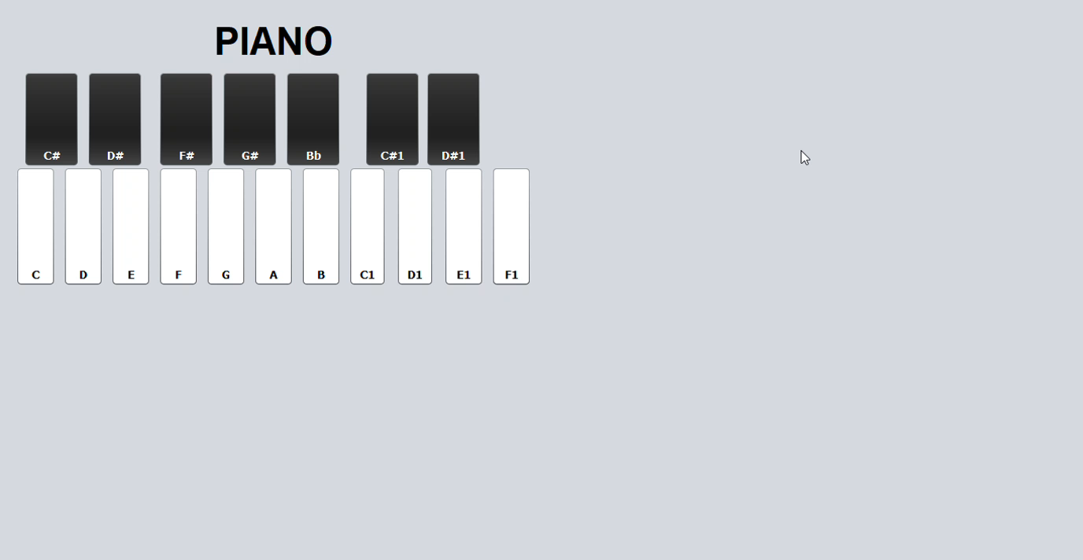
Alternative to keyboard

Slide 5
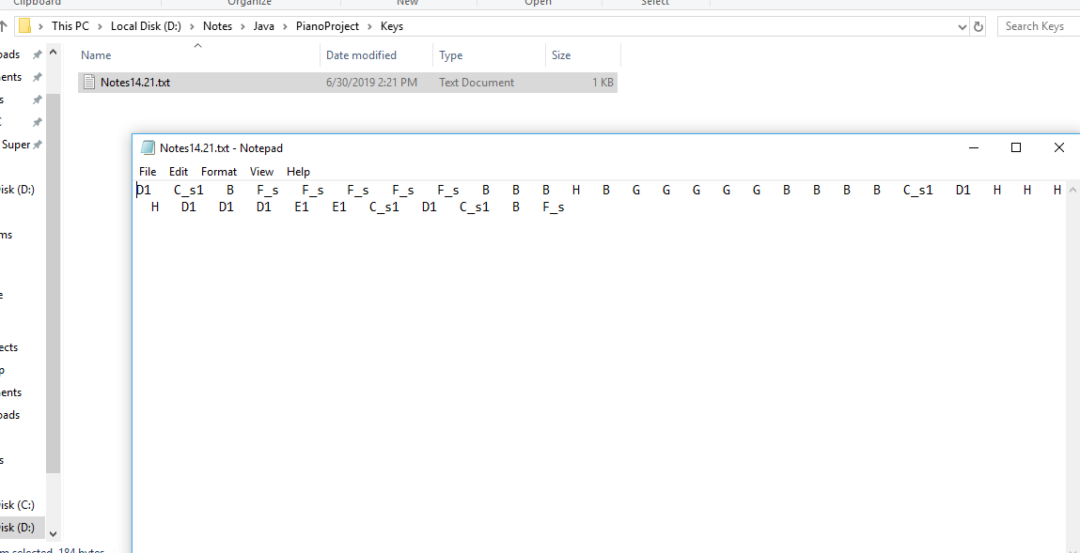
Saving Notes to a .txt file

Slide 6
Challenges
We could not find a way to record sound of the app.
We could not tune the sound.

Slide 7
THANK YOU!

